Slide 1

Visual Analysis of a Moodle-based Software Engineering Course
Francisco J. García (fgarcia@usal.es)
Miguel Á. Conde (mconde@usal.es)
Sergio Bravo (ser@usal.es)
Diego A. Gómez (dialgoag@usal.es)
Roberto Therón (theron@usal.es)
University of Salamanca – GRIAL Research Group
Methods and Cases in Computing Education (MCCE-2011)
Ciudad Real, June 16th, 2011
Held at SPDECE-2011. Multidisciplinary symposium on the design and evaluation of
digital content for education - Ciudad Real, June 15th -17th, 2011

Slide 2
Outline
Introduction
The Problem
Visual analytics
Case study results
Conclusions

Slide 3

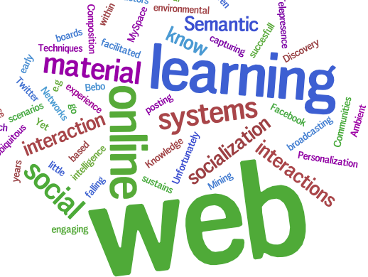

Introduction (I)
GRIAL – Universidad de Salamanca

Slide 4
Introduction (II)
This evolution involves new tools and necesities
LMS as a mean to support and make evolve subjects
  100% of the universities have a LMS
  79,5% of the big companies use these learning tools
  LMS don’t provide the expected benefits
    LMS as spaces to publish courses
    Oriented to a specific period of time
    Focused on the course and institution
    Problems to exploit information of learner activity

Slide 5
Introduction (and III)
LMS must evolve and be complemented with other tools
To define what tools are better, learner information activity must be explored
  Interaction with the LMS
  Participation in different activities
  Interaction with other learners and teachers
  Interest of the learners
Visual analytics tools as a way to do this

Slide 6
Outline
Introduction
The Problem
Visual analytics
Case study results
Conclusions

Slide 7
The Problem (I)
How to analyse information about what learner does
  How to know what are her worries and doubts about the subject?
  What are main important periods of activity?
  How are participating learners in activities and how to take it into account?
  What are main important issues of each subject area?
  And what are those understood worse?
  Is it working a specific tool to improve the subject?
Notes:
And many other questions

Slide 8
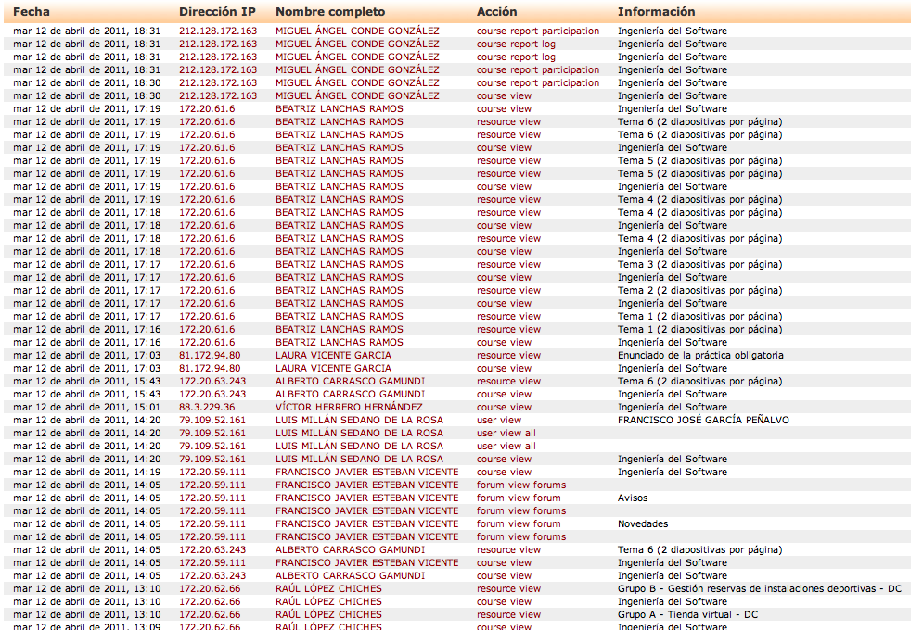
The Problem (II)
To analyse this

Slide 9
The Problem (III)
Extract information
Analysis information
Take decisions

Slide 10
The Problem (IV)
Extract information
  There are several ways to extract information about a LMS
    Direct access to database
    Functions definition to obtain information (hacking the system)
    Standard ways to obtain information (i.e.: Web Services)
Exploit information
  Data mining
  Semantic analysis
  Visual analytics

Slide 11
The Problem (V)
Software Engineering Subject
  Tries to explain a set of principles that are regularly and systematically applied to the development of viable software
  General Concepts
    60 hours (45 theoretical hours and 15 lab hours)
    Focus on
      Lifecycle and process requirement elicitation and documentation
      Analysis and design methods and notation
      Modularity, software architecture, and software reuse principles
    Practical part
      Small project and 10 hours of workshops to solve different model problems

Slide 12
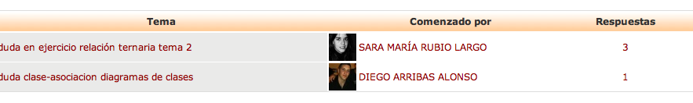
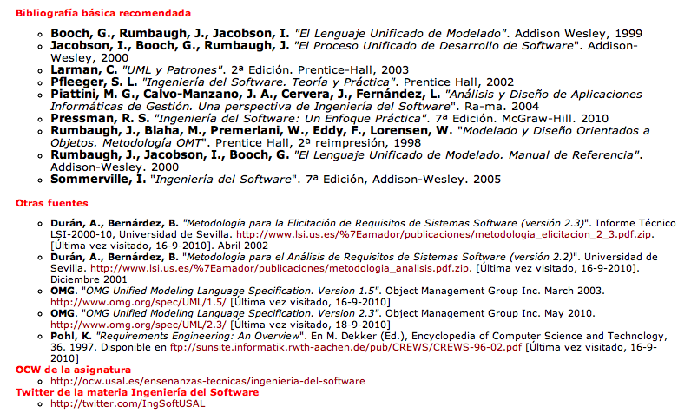
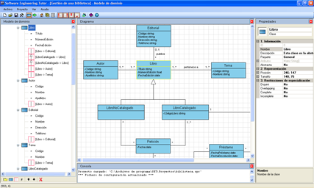
The Problem (VI)
Software Engineering Subject
  Technological features
    Institutional LMS of the University of Salamanca (Studium)

Slide 13
The Problem (and VII)
Software Engineering Subject
  88100 log entries in two academic years
  It is needed to know
    Platform activity level during the academic year
    At what time learners are conected to the platform
    Activity in the forums
    Take into acount learners participation during evaluation processes
    …
Notes:
It would be interesting to observe the level of activity on the platform throughout the duration of the course. In this way, teachers and course designers can determine if in certain periods is somehow necessary to strengthen mentoring, introduce new resources, new tools, etc.
• Also could be considered at what times students are connected to the platform, in order to evaluate whether or not to use synchronous tools into the subject, such as chat or video conference.
• Moreover must be analyzed the activity in the forums, messages and words introduced will be repeated over the subject and at what the user introduces them. In that way can be determined which are the main concerns of students. In addition could be seen if the forums are being used for the real learning of the subject.
• It may be essential to be able to determine the participation of students in the subject. In this way the participation could be taken in to account and assessed students in terms of it.

Slide 14
Outline
Introduction
The Problem
Visual analytics
Case study results
Conclusions

Slide 15
Visual analytics (I)
Visual analytics
  Emerging area for supporting analytical reasoning by interactive visual interfaces
  More that only visualization
    Visualization, Human Factors and Data Analysis
  It allows users to detect expected events and also help them to discover the unexpected
    Surprising anomalies, changes, patterns, relationships …
Notes:
In this case applied to learning and specifically VLE logs

Slide 16
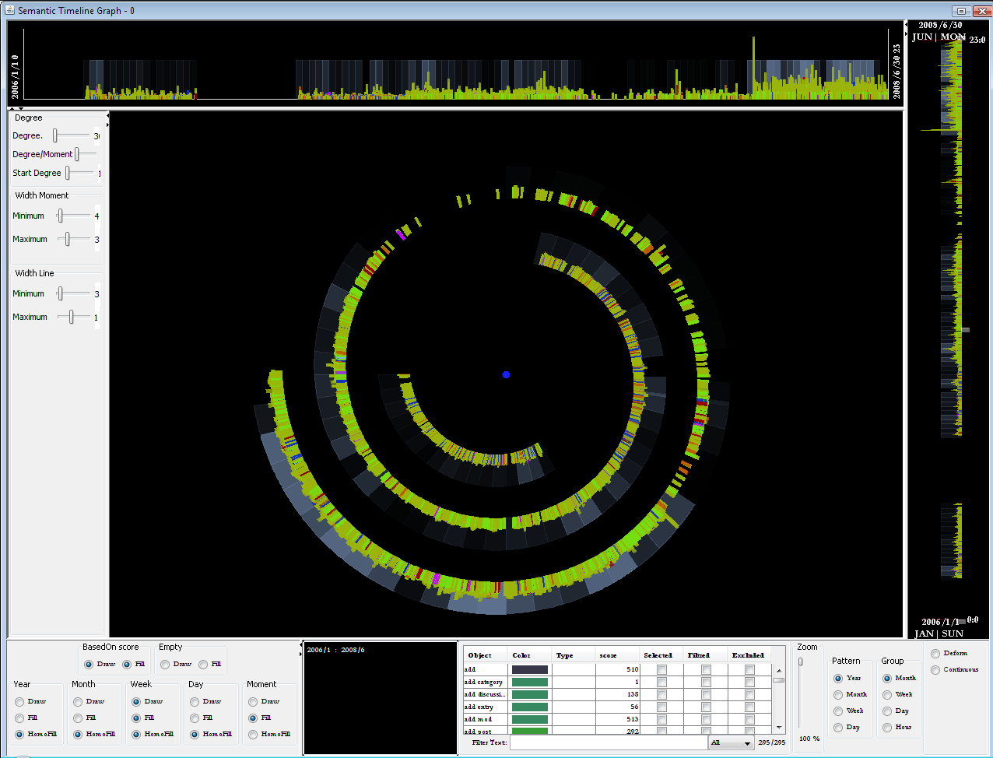
Visual analytics (II)
Tools to analyse information
  Semantic Spiral Timeline
    Considers time dimension
    Representing the overall use of the LMS
    From a global to a specific perspective
      Course, time, person, activity
    Patterns of activity

Slide 17
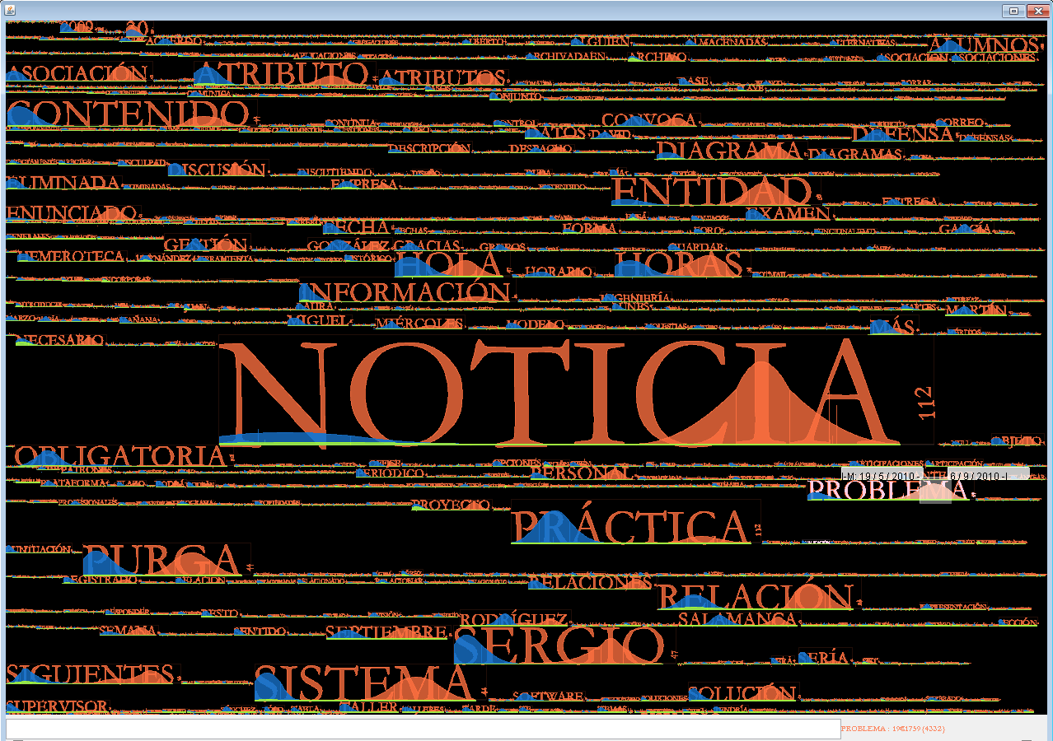
Visual analytics (III)
Tools to analyse information
  Temporal tag-cloud
    Most popular tags in alphabetical order, and visually weighted by font size
    Perceiving importance of data
    Evolution of each tag during the time
    It can be used at different levels
    Other functionalities
      Exclusion of words
      Synonyms
      Exportation of forbidden words

Slide 18
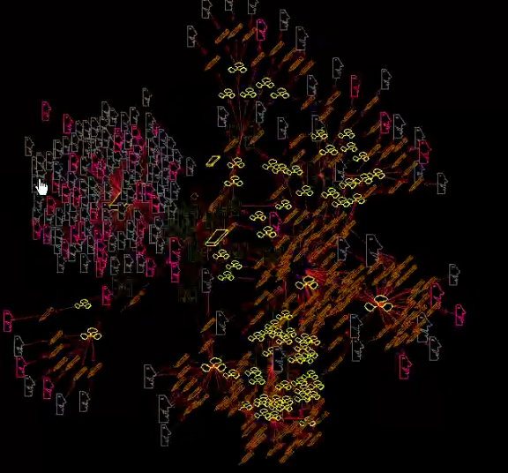
Visual analytics (and IV)
Tools to analyse information
  Social Network Graph
    Massive graph structures of social connectivity
    Represents relationships, links and and frequency of activities of students and teachers
    Icon size depends on the quantity of activity users perform
    Allows exploring participation in the learning system

Slide 19
Outline
Introduction
The problem
The Solution
Case study results
Conclusions

Slide 20
Case Study Results (I)
Case study
  Academic year 2008-2009 and 2009-2010
    88100 log entries
    160 students average
    Four possible sceneries
      Monitoring the activity on the platform
      Tag-cloud application over subject information
      Monitoring a specific theme, forum, discussion or course
      Tracking learners’ participation in the subject

Slide 21
Case Study Results (II)
Case study
  Monitoring the activity of the platform
    SST to check the months greater activity (October, November)
    Incorporation of support staff during this time
    New tools to provide help to users
  Tagcloud application over course information
    51 forums, 114 discussion threads, 172 posts, 26979 forum accesses
    2907/9332 different words
    Uses of forum
      Informative use (News, Notice, Defence, Summons, Review, Time)
      Modelling discussions (Discussion, Entity, Relation, Base, Data, Diagram, Attribute, Model, SET)
      Question solving (USAL, week, problems, practices, doubt, form, Web, Office, Delivery Solution)

Slide 22
Case Study Results (and III)
Case study
  Monitoring a specific theme, forum, discussion or course
    Most relevant words
      When are used
      What kind of action (create, read, update)
    Most relevant forums and threads by using semantic zoom
  Tracking learners’ participation in the subject
    SNG
    What users are participating more
    What discussions are more relevant

Slide 23
Outline
Introduction
The problem
The Solution
Case study results
Conclusions

Slide 24
Conclusions
Technology can improve learning processes but is necessary to know what to include and when to do it
Visual analytics will provide this information
In this way decision taking is easier
  What tools to use
  When to include more staff
  Which issues requires more time or extensive description
  Take into account user participation in her evaluation
Improve the way in which we teach and learn

Slide 25

GRIAL contact
http://grial.usal.es
http://www.facebook.com/grialusal
http://twitter.com/grial_usal
http://grial.usal.es
Notes:
25
25

Slide 26



Acknowledgments
This work is partially supported by the Ministry of Industry, Tourism and Trade of Spain (project IST-020302-2009-35), the Ministry of Education and Science of Spain (project TIN2010-21 695-C02) and the Department of Education of Junta de Castilla y León through the project GR47

Slide 27
Visual Analysis of a Moodle-based Software Engineering Course
Francisco J. García (fgarcia@usal.es)
Miguel Á. Conde (mconde@usal.es)
Sergio Bravo (ser@usal.es)
Diego A. Gómez (dialgoag@usal.es)
Roberto Therón (theron@usal.es)
University of Salamanca – GRIAL Research Group
Methods and Cases in Computing Education (MCCE-2011)
Ciudad Real, June 16th, 2011
Held at SPDECE-2011. Multidisciplinary symposium on the design and evaluation of
digital content for education - Ciudad Real, June 15th -17th, 2011

