Slide 1

The application 2.0 tools through PLEs in Computer Science
Education: The twitter experience
Miguel Ángel Conde (mconde@usal.es)
Francisco J. García Peñalvo (fgarcia@usal.es)
Marc Alier (marc.alier@upc.edu)
Enric Mayol (mayol@essi.upc.edu)
María J. Casany (mjcasany@lsi.upc.edu)
Alicante, Spain, June 13-15, 2012

Slide 2
Outline
Introduction
2.0 Tools, PLEs and Computer Science Education
The Application of 2.0 tools in Learning Environments
Conclusions
SPDECE 2012

Slide 3
Outline
Introduction
2.0 Tools, PLEs and Computer Science Education
The Application of 2.0 tools in Learning Environments
Conclusions
SPDECE 2012

Slide 4

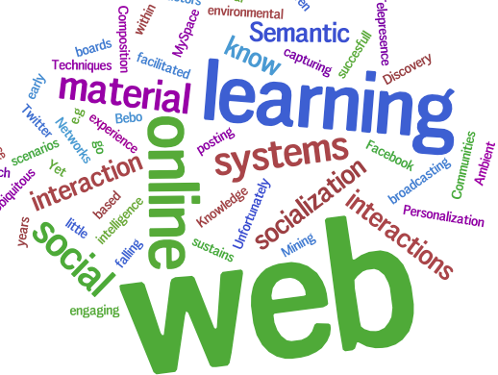

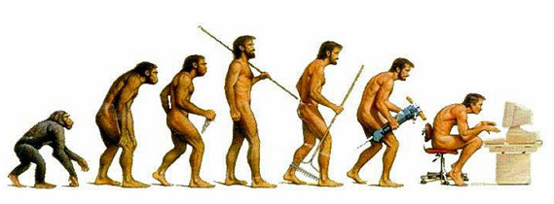
Introduction (I)
SPDECE 2012
GRIAL – Universidad de Salamanca
Notes:
Learning processes are continuously evolving. This development will be linked to sociological, pedagogical, or technological changes. In any case that evolution will result in changes in the way the subjects are organized, structured and taught.

Slide 5
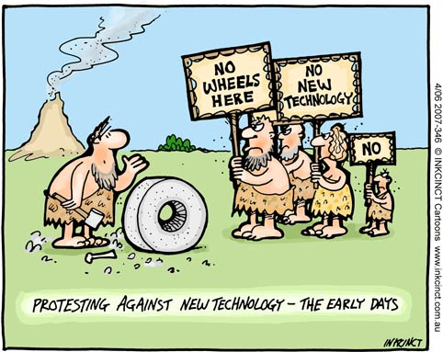
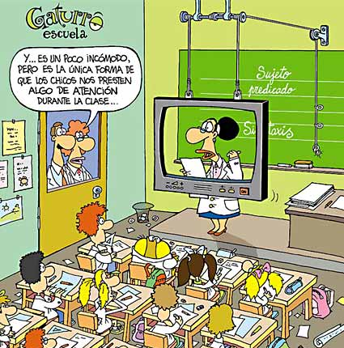
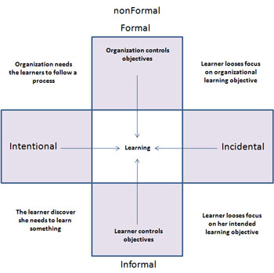
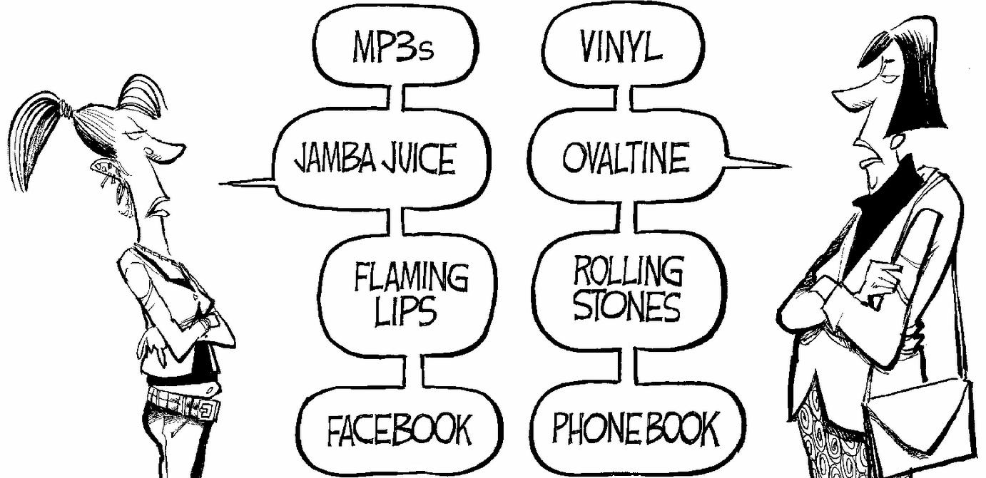
Introduction (and II)
Institutional resistance to change regarding the introduction of certain technologies in formal environments
The lack of connection between the formal,
non-formal and informal environments
The insistence on the technology application when it
is not required or seen as a solution
The need for digital literacy
SPDECE 2012
GRIAL – Universidad de Salamanca

Slide 6
Outline
Introduction
2.0 Tools, PLEs and Computer Science
The application of 2.0 tools in learning environments
Conclusions
SPDECE 2012

Slide 7
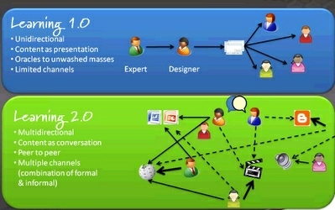
Opportunities provided by PLEs and 2.0 Tools
Education must be supplemented by new paradigms and tools, leading to what has been called eLearning 2.0
eLearning 2.0 means tools that
  Facilitate interaction
  and socialization
  Support digital natives
  and digital immigrants
  Are Student centred
  Support Bologna
  process
SPDECE 2012

Slide 8
LMS and PLEs integration (I)
PLE is a way to support these necessities
The challenge is how to integrate the PLE with the LMS
3 possible scenarios
  No integration
  Opening the LMS
    Web services and interoperability specifications
    Institutional problems to allow the openness
    Communication is usually in one specific direction
  Integration of external tools
    Tools and contexts integration issues
    The user has no freedom to decide what tools to use
    Solutions starting from scratch
SPDECE 2012

Slide 9
LMS and PLEs integration (II)
We propose four possible interoperability scenarios between LMSs and PLEs
  Export of functionality from the LMS to the PLE. The exported functionality is represented in the PLE and provides information about what happens there to the PLE. It will allow the user to introduce formal activities in the informal environments, which will allow him to participate in the institutional activity even when he is learning by other ways
  Use of external tools with external access to them. The user may use an external tool such as Flickr, Blogger, etc. in the PLE and latter the teacher must be able to evaluate student’s activity. In this scenario the teacher needs to access to the external environment to evaluate the activity and later take it into account in the LMS. In this way the informal activity performed outside the institution will be assessed and taken into account
  Use of external tools (with evaluation support) in the PLE, and recover information the LMS. The student would perform the activity in the PLE, in different external tools that have an evaluation interface. The teacher is going to enter into the LMS and will recover automatically the results of the activity carried out on those tools. The activity must be previously auto-evaluated by the tool or should have been evaluated by the teacher. In this case the teacher leads the activity performed in the informal environment
  Use of external tools without evaluation support into the PLE. This scenario is referred to those tools that have not an evaluation interface (i.e.: Google Docs), but could be used to perform learning activities. In this case the LMS instantiate a proxy that will provide the evaluation interface, which allows the teacher to recover the information from the external tools

Slide 10
LMS and PLEs integration (and III)
Second scenario is used in this work
  It is based on an external online tool with a light integration
    It enriches and opens the LMS
    It is easy and cheap to implement
      No real integration between LMS and PLE
    The way in which the PLE is implemented is non-relevant
SPDECE 2012

Slide 11
Outline
Introduction
2.0 Tools, PLEs and Computer Science
The Application of 2.0 Tools in Learning Environments
Conclusions
SPDECE 2012

Slide 12
The application of 2.0 tools in learning environments (I)
The subject
  UPC
  Social and Environmental Aspects of Information Technology (ASAI)
  It can be chosen from Degree in Informatics Engineering, Diploma in Computer Software and Diploma in Computer Systems
  Main aim: learning the environmental, social effects and impact of information technology, its history and the legislation issues
  7.5 credits (5 hours each week, during the 13 or 14 weeks of a term)
  Evaluation
    A final exam (40% of the final grade)
    Two surveys and presentations (30% of the final grade)
    Other activities regarding students’ participation (30% of the final grade)
  During the experience Twitter has represented the 30% of the final grade
SPDECE 2012

Slide 13
The application of 2.0 tools in learning environments (II)
The tool
  Twitter
    It is applied to comment news related to ICT in the subject context
    The activity carried out with twitter and related to the subject is considered in the final grade
    Channelled through the tag #asaifib
  It is necessary to gather and analyse all twits related to the subject
    Twapperkeeper/Hootsuite
SPDECE 2012

Slide 14
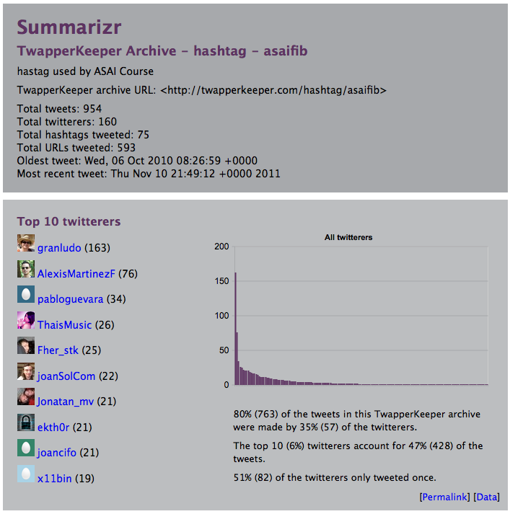
The application of 2.0 tools in learning environments (III)
WSKS 2011

Slide 15
The application of 2.0 tools in learning environments (IV)
The teacher should access to the analysis system (hootsuite), check the activity of each student, analyse the quality of the tweets and evaluate and provide feedback to the user through the offline activity defined in Moodle
The student can review the results and feedback through such activity
This is an easy integration method between the LMS and the 2.0 tools (from a PLE)
SPDECE 2012

Slide 16
The application of 2.0 tools in learning environments (and V)
SPDECE 2012

Slide 17
Outline
Introduction
2.0 Tools, PLEs and Computer Science
The Application of 2.0 Tools in Learning Environments
Conclusions
SPDECE 2012

Slide 18
Conclusions
Learning tools employed by teachers and learners are not only those provided by the institution
Taking into account the learning activities carried out with such tools, the institutional environment can be enriched
The institutional systems are like walled garden and should be open
The consideration of 2.0 tools during subjects increases the student’s participation and gives them the possibility to contact with people from outside the institution such as experts in a specific issue
It is necessary to carry out similar experiences in other contexts
  Less controlled situations
Students’ and teachers’ opinions should be explored from a qualitative perspective
SPDECE 2012

Slide 19


Acknowledgements
This work is partially supported by the Ministry of Industry, Tourism and Trade of Spain (project IST-020302-2009-35), the Ministry of Education and Science of Spain (project TIN2010-21695-C02) and the Government of Castilla y León through the project GR47

Slide 20
The application 2.0 tools through PLEs in Computer Science
Education: The twitter experience
Miguel Ángel Conde (mconde@usal.es)
Francisco J. García Peñalvo (fgarcia@usal.es)
Marc Alier (marc.alier@upc.edu)
Enric Mayol (mayol@essi.upc.edu)
María J. Casany (mjcasany@lsi.upc.edu)
Alicante, Spain, June 13-15, 2012

